Slide 1
Choices: student version
By: Adib Thaqif

Slide 2
Overview
Inspired by 20 questions & reigns game
Choice based card game revolving around a typical college student
Purpose: “survive” college years by balancing three aspects: study, work and life (open to suggestions)
Each aspect starts off with 50%.
Constantly choosing one out two choices that affects the aspects (increases or decreases one or more of those aspects)
If one of the aspect bars goes too low or too high, player “loses” one life (punishment system, open to suggestions)

Slide 3

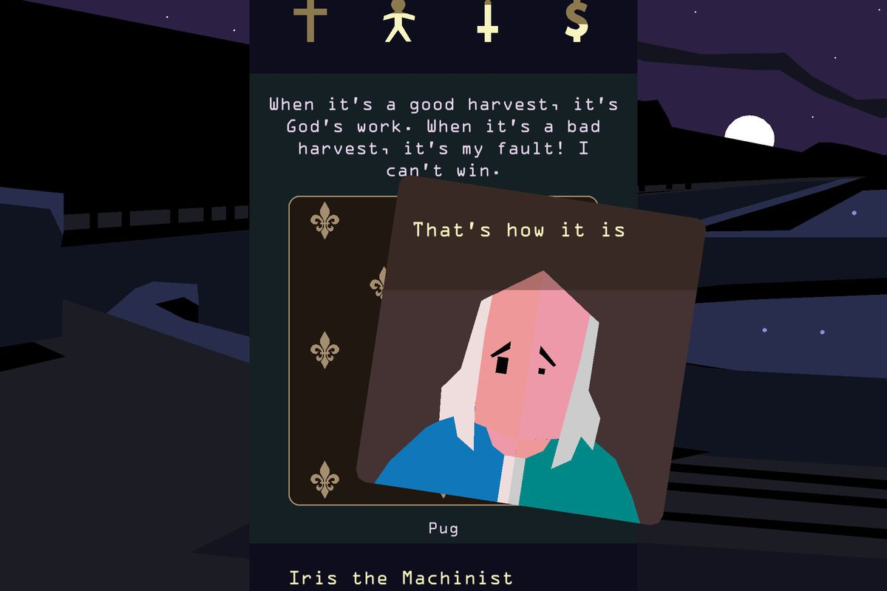
Reigns game

Slide 4
overview
As a way to expand the game, if the player survives after X rounds(subject to more research), player can add a scenario that consists of two choices.
The game has X final out comes: graduate, drop out, drop out with job….
Final outcomes depends on the final percentage of aspect bars or the last choice in the final round.
Player has X hints that can be used throughout the game to help make better choices (subject to more research)

Slide 5

features
MAIN. Have x options: start game, save, view high scores, hints, quit game
GAME. Interface include player’s info, prompt, choices and aspect bars

Slide 6
Course materials
HASH TABLES. Used to store choices and their aspect impact. Example: do homework ( +5% study, -2% life )
GRAPHS / PRIORITY QUEUE. Can be used to provide hints for smartest choice to pick.
SORTING ALGORITHM. Sorts prompts based on aspect impact.

